Slide 1
SKIPPER Technical Product Presentation
Speed logs:
The Technologies
The advantages and disadvantages
Design into a vessel
Installation and setup
Service and support
Echosounders:
The Technologies
The advantages and disadvantages
Design into a vessel
Installation and setup
Service and support
SKIPPER Electronics AS
Enebakkveien 150
0680 Oslo
www.skipper.no
Tlf. +47 23 30 22 70
Fax +47 23 30 22 71
sales@skipper.no
support@skipper.no

Slide 2
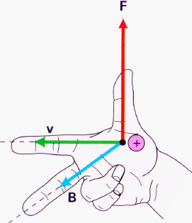
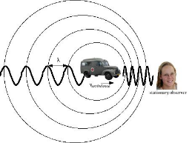
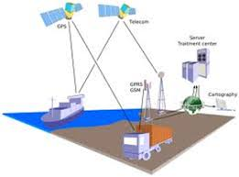
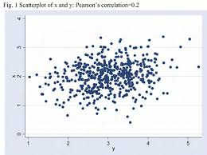

Speed log technologies
Rope with knots in it
Impeller towed behind a vessel
Impeller mounted on a vessel hull
Electromagnetic sensor – generating small currents
Doppler using the change of frequency as particals move towards the sensor
GPS – using a changing triangulated position in time, sometimes combined with the Doppler effect of the signals as they arrive
Correlation – Taking an acoustic snapshot of the particals, and then ashort time afterwards doing the same and measuring the difference using correlation techniques
RADAR – using the existing or a special radar to measure doppler movement of the surface of the water
SKIPPER Electronics AS
Enebakkveien 150
0680 Oslo
www.skipper.no
Tlf. +47 23 30 22 70
Fax +47 23 30 22 71
sales@skipper.no
support@skipper.no

Slide 3

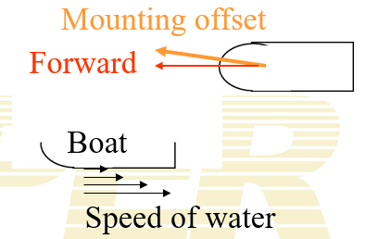
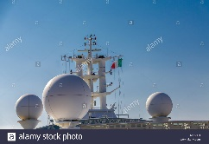
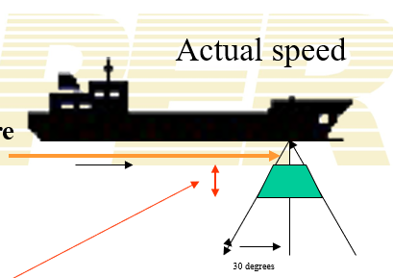
Speed log technologies - challenges
Speed through water only
Rope – inconvenient
Impeller – growth
Electromagnetic – Measures on the surface of the hull, need some calibration with growth
Radar – measures at surface. weather will have an effect, expensive, unless it uses ships radar, and then not standalone
SOG only
GPS – antenna position and short term effect due to movement of the vessel, and blind zones, no depth limitation
SOG and STW
Doppler few problems, measures at a distance from the hull, SOG is depth limited
Correlation, quite complex, measures vertically, usually 2 systems. SOG is depth limited
SKIPPER Electronics AS
Enebakkveien 150
0680 Oslo
www.skipper.no
Tlf. +47 23 30 22 70
Fax +47 23 30 22 71
sales@skipper.no
support@skipper.no

Slide 4
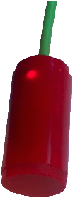
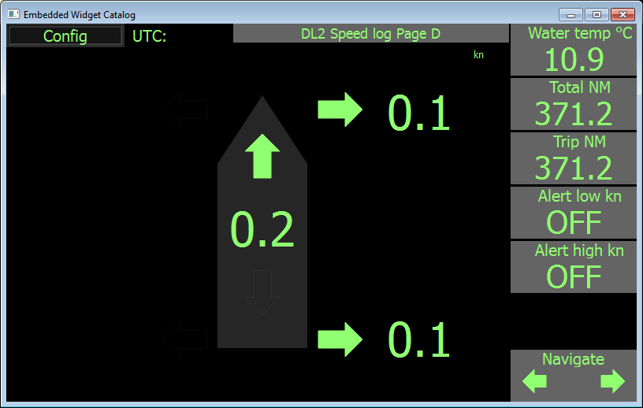
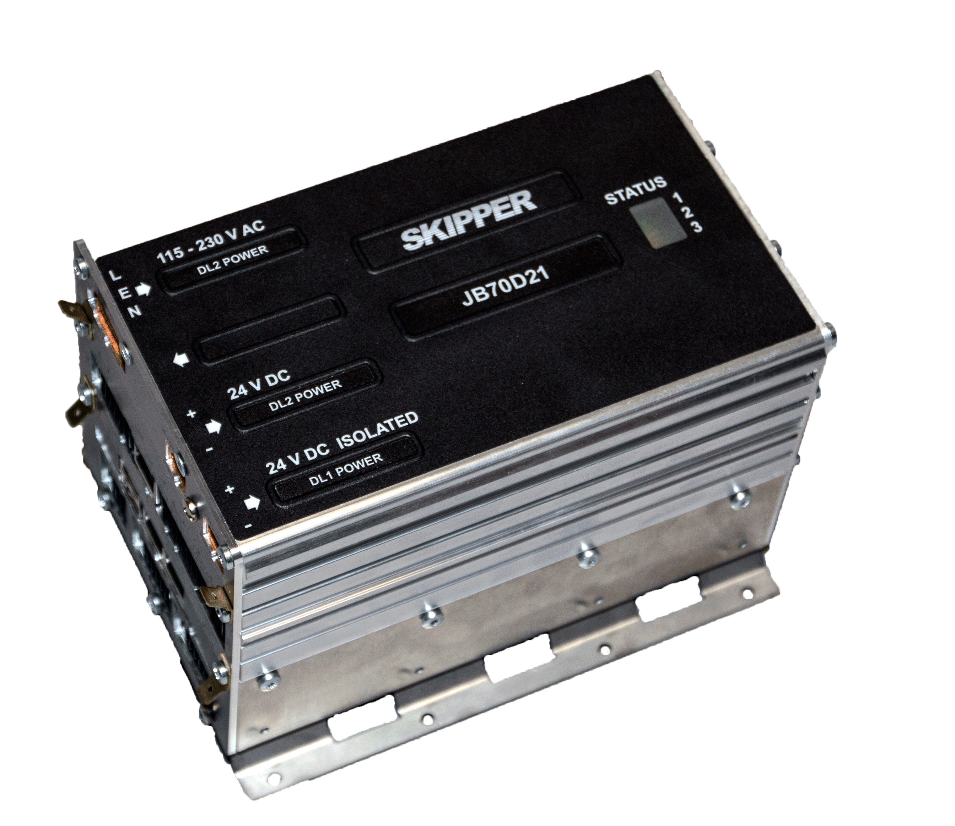
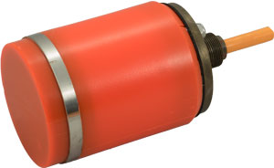
SKIPPER Speed Log
SKIPPER EML224 Compact Electromagnetic
Small sensor 60mm, 1 or 2 axis, low cost, smart sensor
Temp sensor
SKIPPER DL1 Doppler – single axis Doppler
Small sensor 60mm, 1 Axis Doppler (forward and aft beam), low cost, smart sensor
Temp sensor
SKIPPER DL2 Doppler
100mm sensor, 2 axis STW and SOG, depth , temp, tilt. Smart sensor
Multiple frequencies, for higher accuracy/ robustness
Accurate, after calibration
SKIPPER DL21 Doppler
- Dual/Combined DL2 DL1 in 100mm housing, dual system for vessels over 50kGRT
SKIPPER Electronics AS
Enebakkveien 150
0680 Oslo
www.skipper.no
Tlf. +47 23 30 22 70
Fax +47 23 30 22 71
sales@skipper.no
support@skipper.no

Slide 5
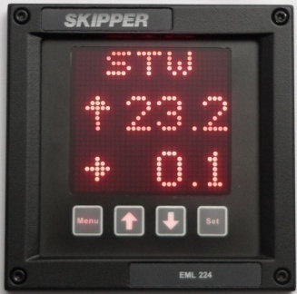
SKIPPER Speed Log
COMING 2021
SKIPPER EML224 Compact Electromagnetic
Small sensor 60mm, 1 or 2 axis, low cost, smart sensor
Temp sensor
SKIPPER DL1 Doppler – single axis Doppler
Small sensor 60mm, 1 Axis Doppler (forward and aft beam), low cost, smart sensor
Temp sensor
COMING 2021
SKIPPER Electronics AS
Enebakkveien 150
0680 Oslo
www.skipper.no
Tlf. +47 23 30 22 70
Fax +47 23 30 22 71
sales@skipper.no
support@skipper.no

Slide 6
SKIPPER Speed Log
SKIPPER EML224 Compact Electromagnetic
Small sensor 60mm, 1 or 2 axis, low cost, smart sensor
Temp sensor
SKIPPER DL1 Doppler – single axis Doppler
Small sensor 60mm, 1 Axis Doppler (forward and aft beam), low cost, smart sensor
Temp sensor
SKIPPER DL2 Doppler
100mm sensor, 2 axis STW and SOG, depth , temp, tilt. Smart sensor
Multiple frequencies, for higher accuracy/ robustness
Accurate, after calibration
SKIPPER DL21 Doppler
- Dual/Combined DL2 DL1 in 100mm housing, dual system for vessels over 50kGRT
SKIPPER Electronics AS
Enebakkveien 150
0680 Oslo
www.skipper.no
Tlf. +47 23 30 22 70
Fax +47 23 30 22 71
sales@skipper.no
support@skipper.no

Slide 7

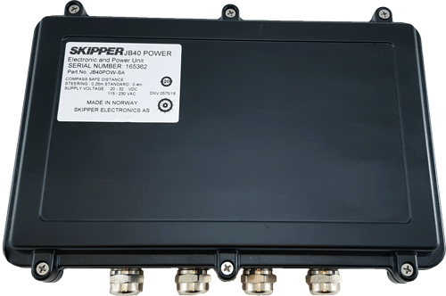
SKIPPER Speed Log
SKIPPER EML224 Compact Electromagnetic
SKIPPER DL1 Doppler – single axis Doppler
SKIPPER DL2 Doppler
SKIPPER DL21 Doppler
SKIPPER SATLOG SL1200
- Basic Satlog SOG system, with dual antenna simple junction box and display, no external equipment (Gyro) needed
SKIPPER Electronics AS
Enebakkveien 150
0680 Oslo
www.skipper.no
Tlf. +47 23 30 22 70
Fax +47 23 30 22 71
sales@skipper.no
support@skipper.no

Slide 8

SKIPPER Speed Log
SKIPPER EML224 Compact Electromagnetic
SKIPPER DL1 Doppler – single axis Doppler
SKIPPER DL2 Doppler
SKIPPER DL21 Doppler
SKIPPER SATLOG SL1200
SKIPPER SATLOG SD21
- Combined Satlog and DL1 for vessels requiring separate SOG and STW systems
SKIPPER Electronics AS
Enebakkveien 150
0680 Oslo
www.skipper.no
Tlf. +47 23 30 22 70
Fax +47 23 30 22 71
sales@skipper.no
support@skipper.no

Slide 9
SKIPPER Speed Log
SKIPPER EML224 Compact Electromagnetic
SKIPPER DL1 Doppler – single axis Doppler
SKIPPER DL2 Doppler
SKIPPER DL21 Doppler
SKIPPER SATLOG SL1200
SKIPPER SATLOG SD21
SKIPPER EMES60
- Combined EML and Echosounder for a minimum spec vessel, low cost, single 60mm transducer
SKIPPER Electronics AS
Enebakkveien 150
0680 Oslo
www.skipper.no
Tlf. +47 23 30 22 70
Fax +47 23 30 22 71
sales@skipper.no
support@skipper.no

Slide 10
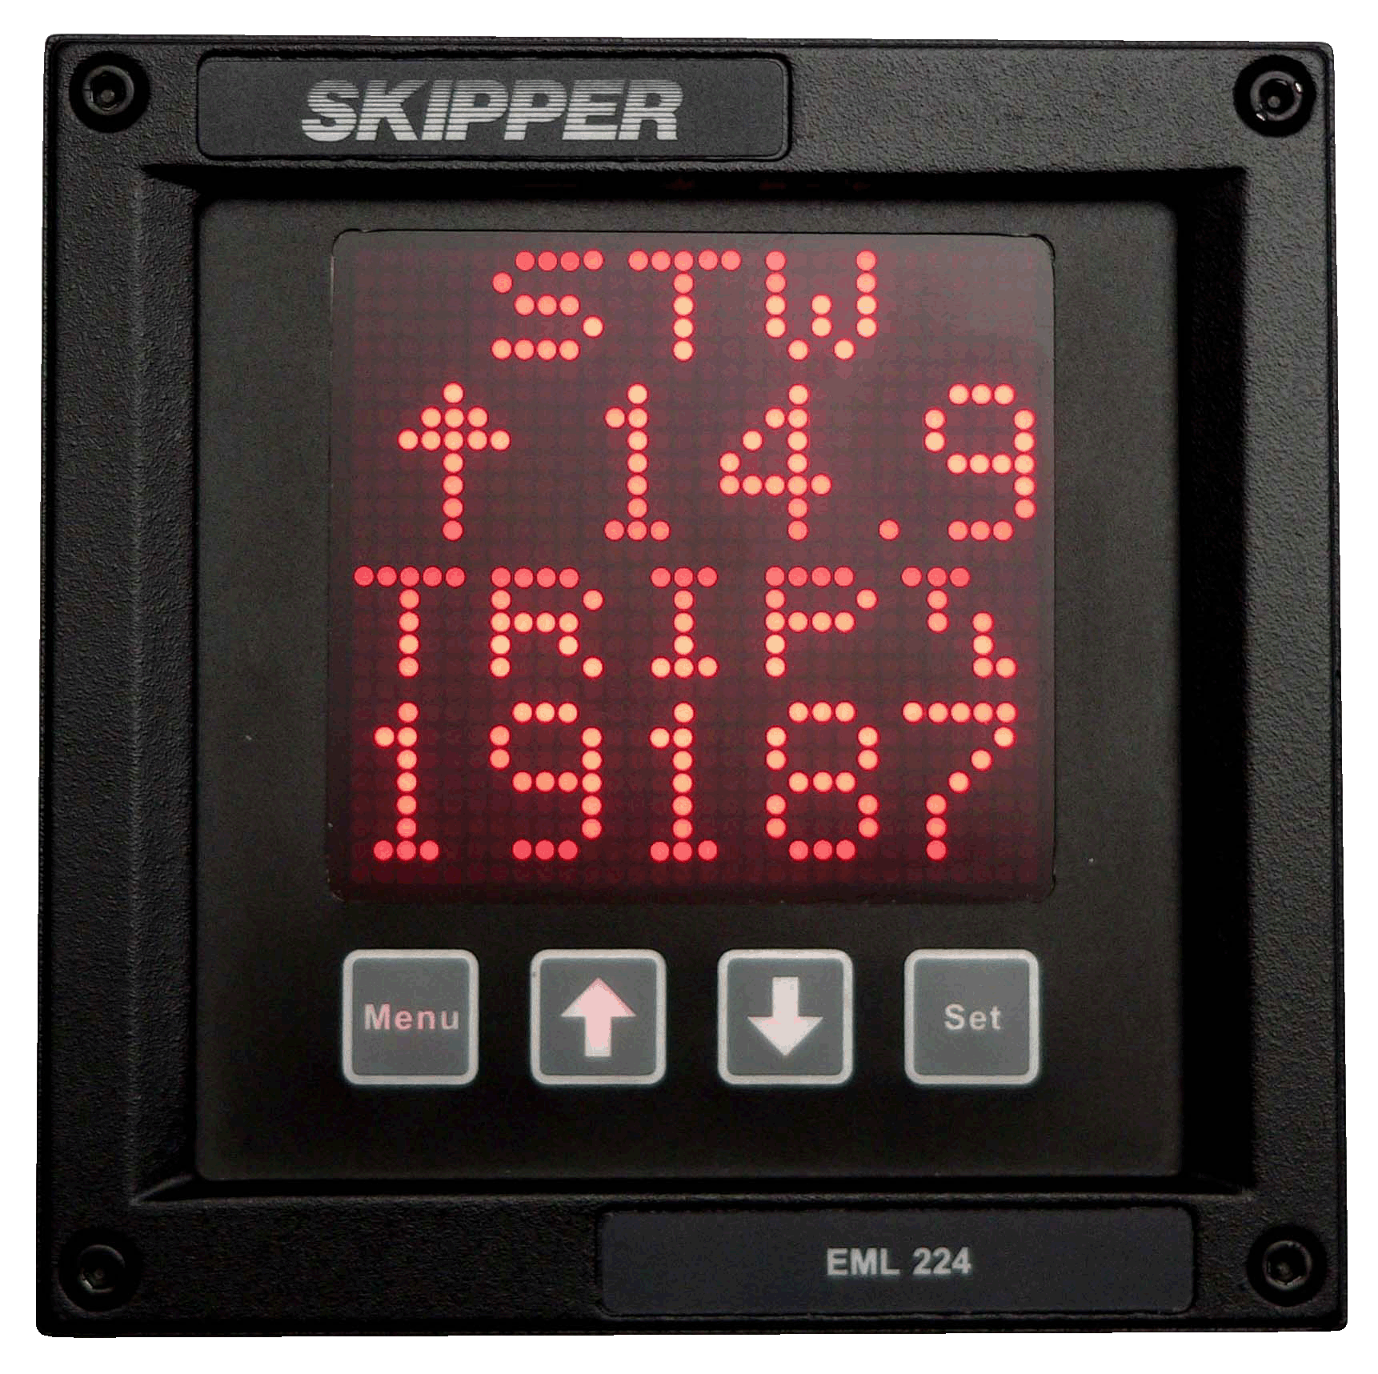
SKIPPER Speed Log
SKIPPER EML224 Compact Electromagnetic
SKIPPER DL1 Doppler – single axis Doppler
SKIPPER DL2 Doppler
SKIPPER DL21 Doppler
SKIPPER SATLOG SL1200
SKIPPER SATLOG SD21
SKIPPER EMES60
SKIPPER Digital Speed Log Repeater
- A multi repeater display that can show up to 6 informations, (2 at one time), from most bridge devices.
Modes:
  • Depth – below surface, keel and transducer
  • Speed – over ground and through water
  • Distance – total/trip for both groundspeed and waterspeed
  • Heading – true, magnetic and relative
  • Rotation – rate of turn and direction
  • Wind – speed and direction (true, magnetic and relative)
  ^{• Temp. – water and air}
  • Drive – RPM, propeller pitch and rudder position
  • Clock – UTC, local time and expected time of arrival
SKIPPER Electronics AS
Enebakkveien 150
0680 Oslo
www.skipper.no
Tlf. +47 23 30 22 70
Fax +47 23 30 22 71
sales@skipper.no
support@skipper.no

Slide 13
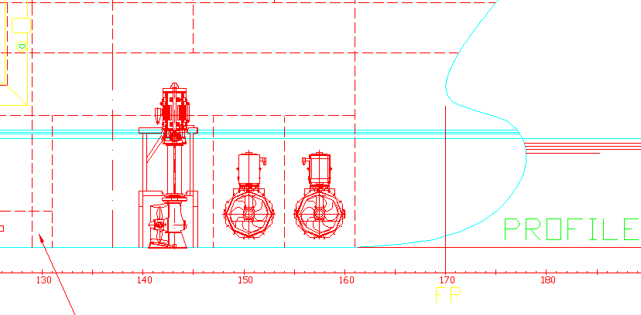
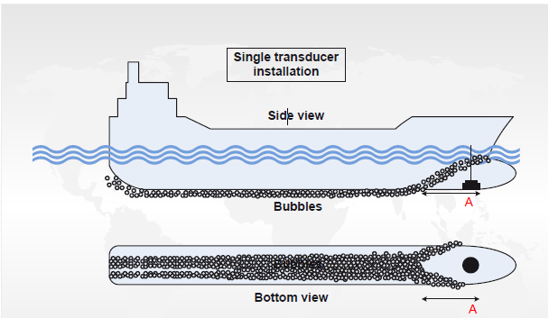
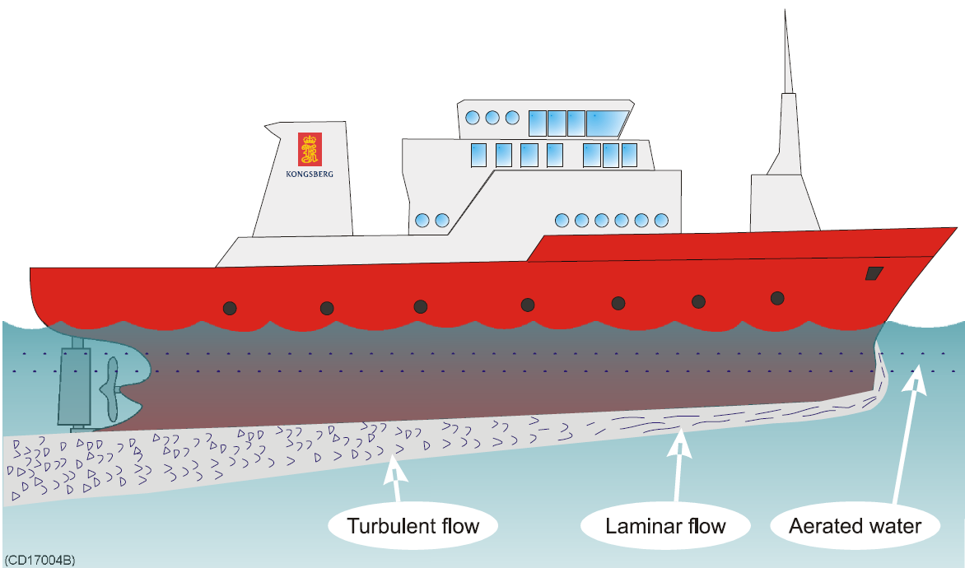
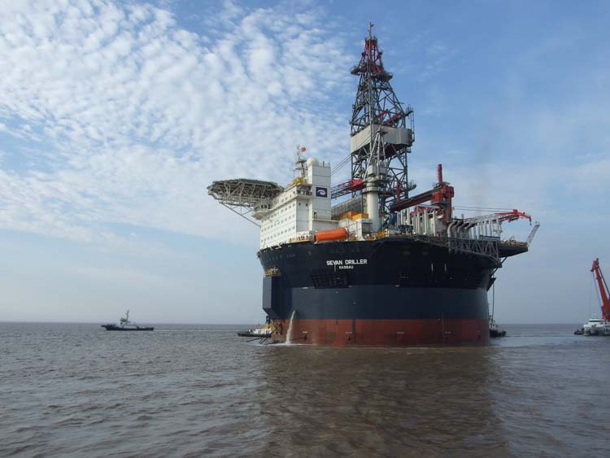
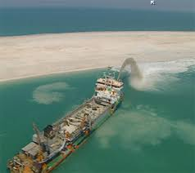
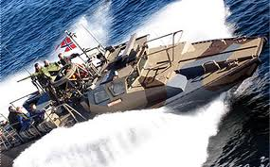
SKIPPER Speed Logs - Placement
Placement- Flush, laminar flow
Cabling (3/4 tsp shielded cable):
  Digital, Low noise, thick enough for 24VDC (loop resistance < 9 ohm)
  Possible to double pairs to half resistance
Recommended
SKIPPER Electronics AS
Enebakkveien 150
0680 Oslo
www.skipper.no
Tlf. +47 23 30 22 70
Fax +47 23 30 22 71
sales@skipper.no
support@skipper.no

Slide 14
SKIPPER Speed Log – setup – (demo)
All skipper Multi graphic systems have a similar look and feel (2021)
Setup/installation
Check the sensor is in place and is flush
Set up ships parameters.
  Ship length, tonnage,
  sensor position
Set up the communications
  NMEA – Output to VDR, Navigation, Radar
  AUX, Drive systems, alarms, ….
  Alarms, BAM or conning
  LAN – Displays, INS, service
Test using simulators, in diagnostic menu
Sea test:
Calibrate the system
Speed (Not Satlog)
Mounting Angles
Log data and check.
SKIPPER Electronics AS
Enebakkveien 150
0680 Oslo
www.skipper.no
Tlf. +47 23 30 22 70
Fax +47 23 30 22 71
sales@skipper.no
support@skipper.no

Slide 15
SKIPPER Speed Log – service and support
All skipper Multi graphic systems have a similar method
Before service
Self test and diagnostic results in diagnostic page
Log data use Graphlog software / send to skipper,
  DL2 / DL21 / SD21 put in a USB stick
  EML224/DL1/SL1200 Send screen shots of diagnostics and sensor data
  or LAN Log using service software (to be changed to USB in 2021)
Vessel connects local PC with anydesk to wifi and LAN port, install service software and windows PC display software. Diagnostics can be performed remotely.
Calibration adjustments can be performed remotely or using the log files.
Visit to vessel to swap out a PCB or sensor
SKIPPER Electronics AS
Enebakkveien 150
0680 Oslo
www.skipper.no
Tlf. +47 23 30 22 70
Fax +47 23 30 22 71
sales@skipper.no
support@skipper.no

Slide 16
SKIPPER Technical Product Presentation
Speed logs:
The Technologies
The advantages and disadvantages
Design into a vessel
Installation and setup
Service and support
Echosounders:
The Technologies
The advantages and disadvantages
Design into a vessel
Installation and setup
Service and support
SKIPPER Electronics AS
Enebakkveien 150
0680 Oslo
www.skipper.no
Tlf. +47 23 30 22 70
Fax +47 23 30 22 71
sales@skipper.no
support@skipper.no

Slide 17
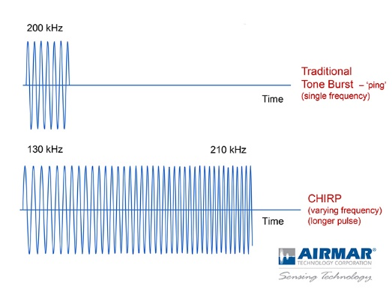
Echosounder technologies
Rope with weight
Banging the hull and listening for echo
Acoustics
  Different frequencies (lower =further, higher= better resolution)
  Different transducer diameters (Larger = thinner beam)
Different Processing techniques
  Narrow band (1 frequency) Simple, Low cost, good for shallow, and medium distances, suffers from noise
  Wide band (multiple frequency Chirp), higher cost, more power more accuracy – good for long distance, noise reduction
SKIPPER Electronics AS
Enebakkveien 150
0680 Oslo
www.skipper.no
Tlf. +47 23 30 22 70
Fax +47 23 30 22 71
sales@skipper.no
support@skipper.no

Slide 18
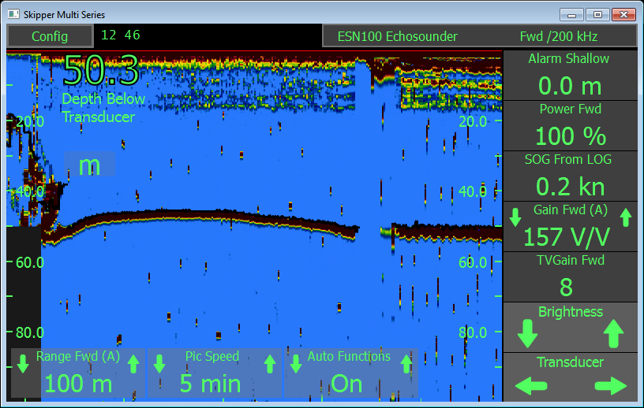
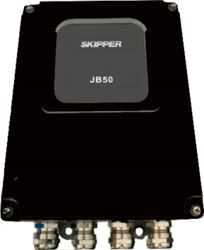
SKIPPER Echosounders
The ESN series have focussed on:
  Reliability
  Modern design
    9” displays
    LAN coms
  Automatic functions
    All automatic, local adjustments
  Easy setup
    Transducers
    Dynamic noise adjustment
  Optimalised for
    Shallow measurements
    Deep measurements
  INS (ESN200)
  Remote service
  Options
SKIPPER Electronics AS
Enebakkveien 150
0680 Oslo
www.skipper.no
Tlf. +47 23 30 22 70
Fax +47 23 30 22 71
sales@skipper.no
support@skipper.no

Slide 19
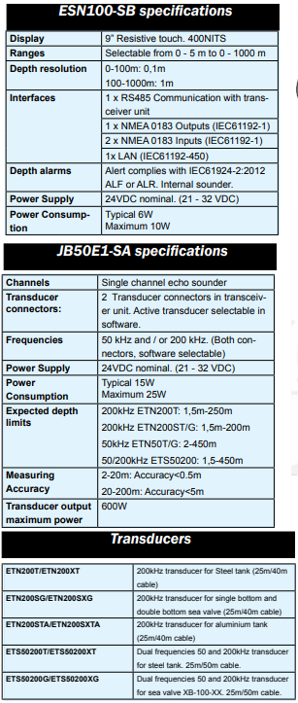
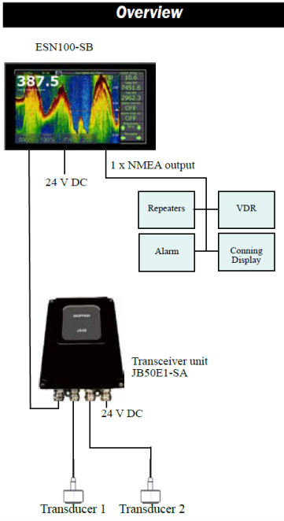
SKIPPER Echosounders
ESN100
  Low cost, single channel (2 inputs) 50 and/or 200kHz
  Limited IO
    LAN, NMEA, alarm relay
  24VDC input to JB50E1
  JB50E1 to display is RS485
    1 pair
    Transceiver can be mounted near the transducer
SKIPPER Electronics AS
Enebakkveien 150
0680 Oslo
www.skipper.no
Tlf. +47 23 30 22 70
Fax +47 23 30 22 71
sales@skipper.no
support@skipper.no

Slide 20
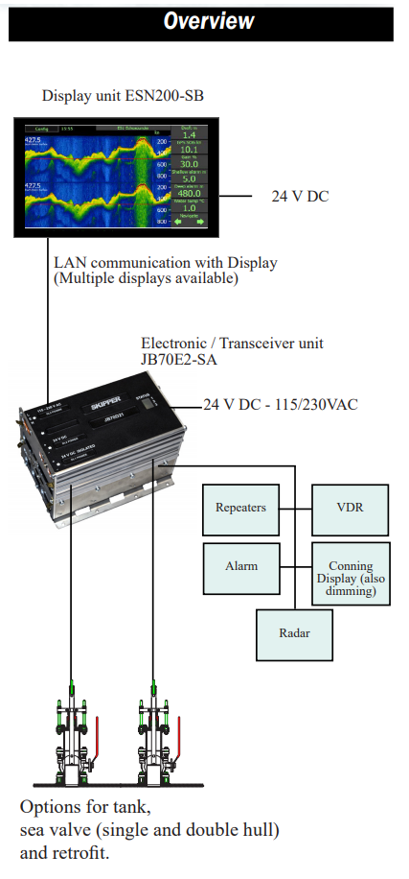
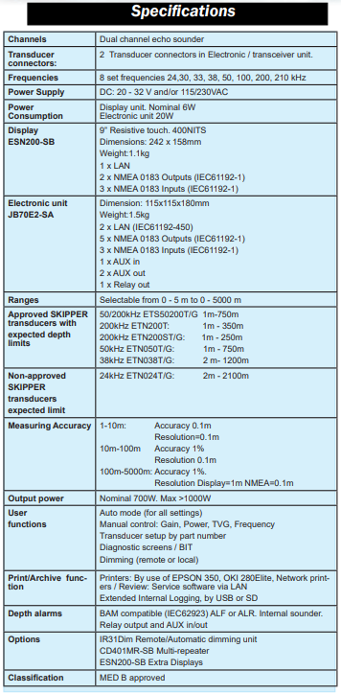
SKIPPER Echosounders
ESN100
ESN200
  Dual channel,
  Multiple frequencies, Narrow band
  Logging / Printer options
  Full IO ( 6x NMEA, Aux in and out, 2 x LAN)
  INS compatible (Windows PC software available, web on the way)
  Multiple displays
  Many options
    Synch
    Mute
    Temperature compensation
SKIPPER Electronics AS
Enebakkveien 150
0680 Oslo
www.skipper.no
Tlf. +47 23 30 22 70
Fax +47 23 30 22 71
sales@skipper.no
support@skipper.no

Slide 21
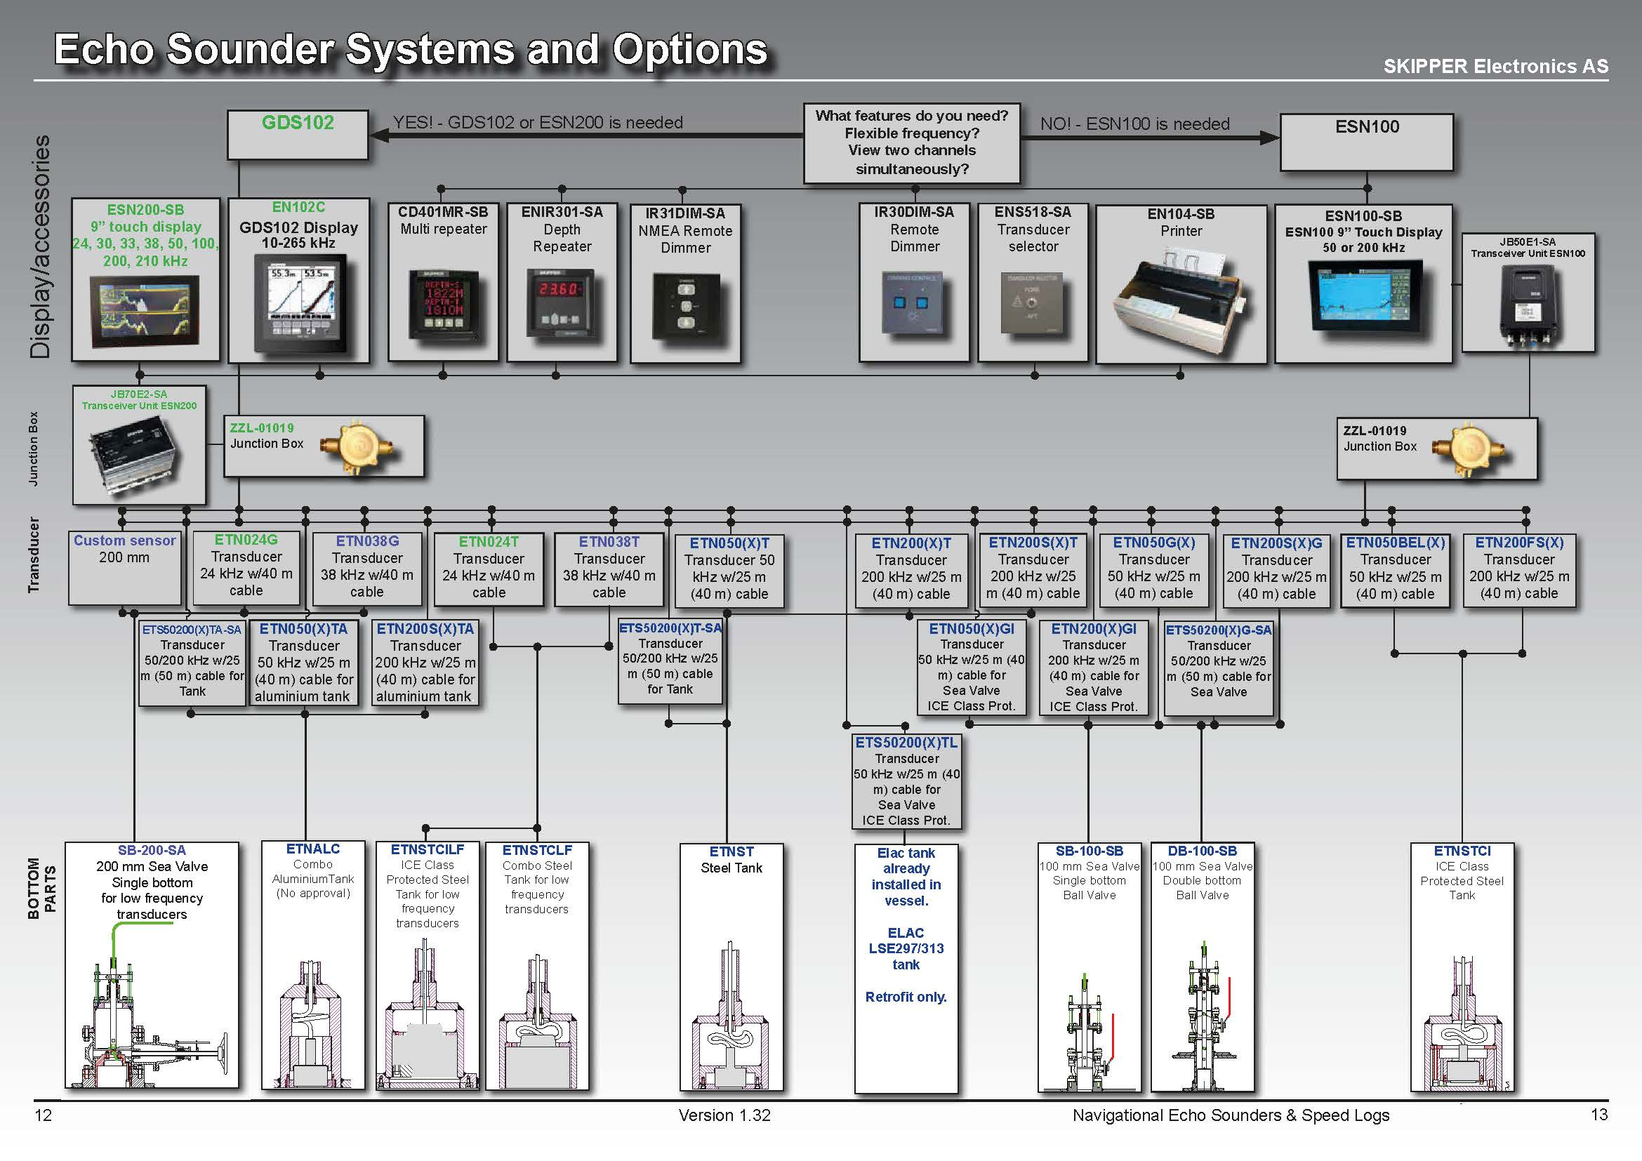

Slide 22
Echosounder - design into vessel
Positioning / Planning
  FWD
    First 1/6 of the hull,
    In front of thrusters, or any other protrusions
    Laminar (even) flow as few bubbles as possible
    This may be only working transducer at speed, so place lower freq here.
    As low down as possible, and point vertical < 5°
  AFT
    Avoid bubbles if possible, may only work at low speed,
SKIPPER Electronics AS
Enebakkveien 150
0680 Oslo
www.skipper.no
Tlf. +47 23 30 22 70
Fax +47 23 30 22 71
sales@skipper.no
support@skipper.no

Slide 23
Echosounder - Installation
Installation
  Install the unit
  Connect transducers,
    Cabling to not be close to electrical noise
    Cable shield to be grounded only at the transceiver / Electronic unit
    Cabling from transducer is analog, 1.5mm (100m) , 2.5mm (300m)
    Connect communications and alarm (GPS input, VDR, Nav)
  Check noise levels, if necessary add power filter.
  If needed adjust the auto noise levels using the auto calibration function
  System can run for a short time in air
  Sea test
  Check all is working, that noise level is low (self test)
SKIPPER Electronics AS
Enebakkveien 150
0680 Oslo
www.skipper.no
Tlf. +47 23 30 22 70
Fax +47 23 30 22 71
sales@skipper.no
support@skipper.no

Slide 24
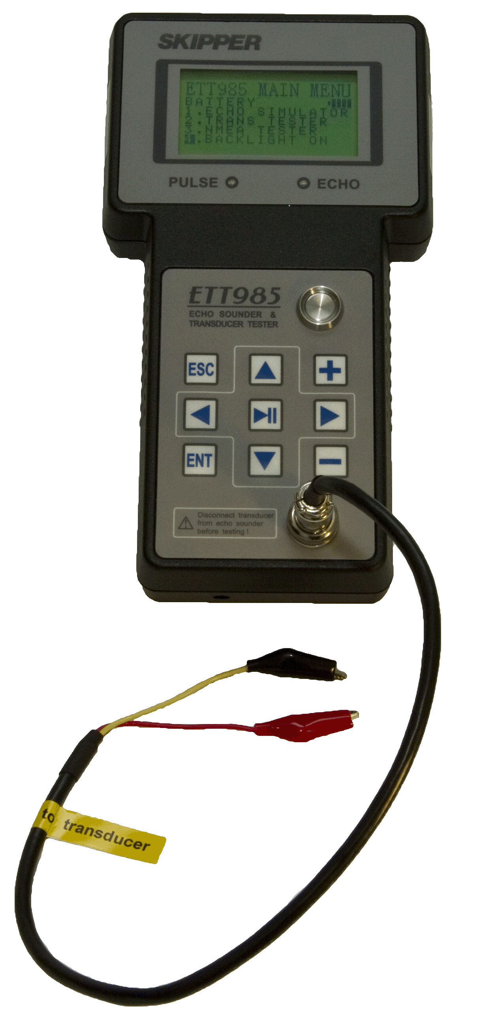
Echosounder – Service / Diagnostics
Log onto USB / SD
Look at noise levels
Adjust levels
Test with ETT to see if there is problem with transducer or sounder
ETT985 Transducer/Echotester
Tester for transducer frequencies from 10 kHz to 1 MHz
Simulator for SKIPPER and other continuous wave Echo Sounders
NMEA tester
Programmable tests with SKIPPER service software
SKIPPER Electronics AS
Enebakkveien 150
0680 Oslo
www.skipper.no
Tlf. +47 23 30 22 70
Fax +47 23 30 22 71
sales@skipper.no
support@skipper.no

Slide 25
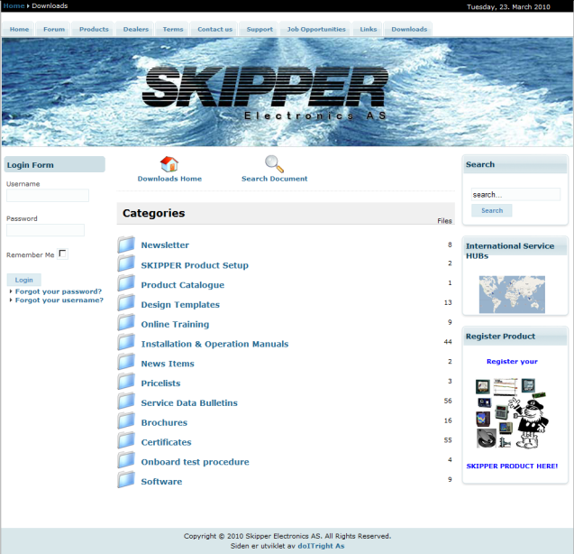
www.skipper.no
Brochures
Manuals
CAD files
Certificates
Video courses
Operation and installation manuals
Software
  Software updates
  PC software
  Simulator software
  Analysis software
  Free skipper service software
Information about service agents and distributors
HAT/SAT procedures
SKIPPER Electronics AS
Enebakkveien 150
0680 Oslo
www.skipper.no
Tlf. +47 23 30 22 70
Fax +47 23 30 22 71
sales@skipper.no
support@skipper.no

Slide 26
Contacts
SKIPPER Electronics AS
  Tlf. 23 30 22 70
  Fax. 23 30 22 71
  E-mail: sales@skipper.no
  Service: support@skipper.no
SKIPPER Electronics AS
Enebakkveien 150
0680 Oslo
www.skipper.no
Tlf. +47 23 30 22 70
Fax +47 23 30 22 71
sales@skipper.no
support@skipper.no

Slide 27
Future web courses
DL2 Calibration
  Getting the system to measure correctly on a sea trial
DL2 Advanced Calibration – getting to 1%
  Getting the system to use its full potential
Integrated solutions, now and the future
  Now and tomorrow, Application or web?
What else?
SKIPPER Electronics AS
Enebakkveien 150
0680 Oslo
www.skipper.no
Tlf. +47 23 30 22 70
Fax +47 23 30 22 71
sales@skipper.no
support@skipper.no

